Slide 1
DATA SCIENCE

Slide 2
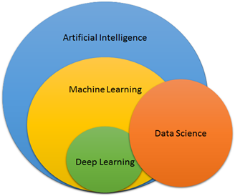

Slide 3
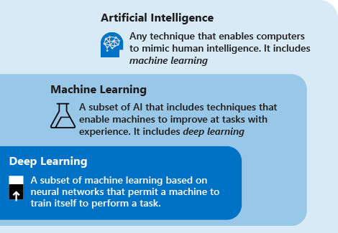
SUBSETS…

Slide 4
DATA SCIENCE IS…
Asking the correct questions and analyzing the raw data.
Modeling the data using various complex and efficient algorithms.
Visualizing the data to get a better perspective.
Understanding the data to make better decisions and finding the final result.

Slide 5
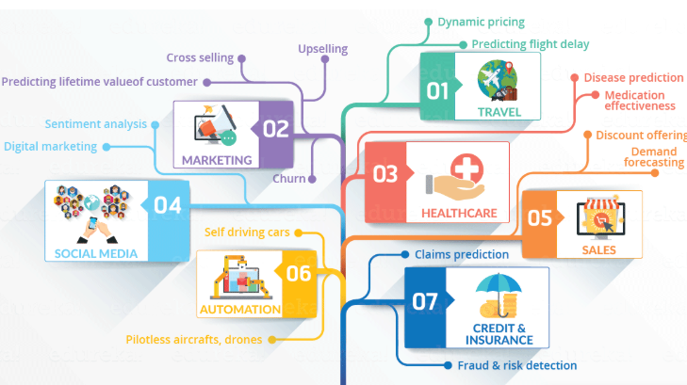

Slide 6
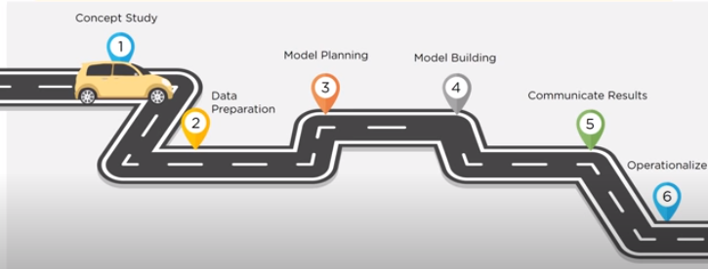
LIFE CYCLE OF DATA SCIENCE

Slide 7
PREREQUISITES
Understanding of:
Data
Algorithms/logic
Programming
Statistics
Business Domain

Slide 8
PANDAS
Pandas is an open source, BSD-licensed library providing high-performance, easy-to-use data structures and data analysis tools for the Python programming language.
Pandas stands for ‘Python Data Analysis Library’ and the name is derived from panel data which is an econometric term for multidimensional datasets.

Slide 9
AGENDA
What is Data frames
What is Data Series
Different operations in Pandas

Slide 10
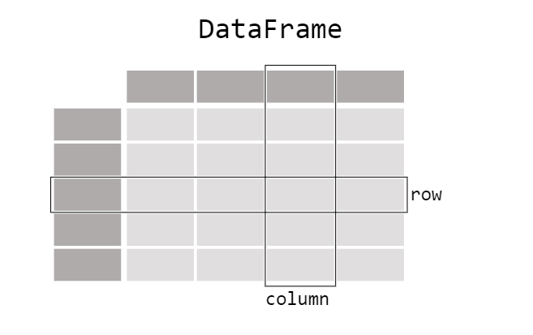
DATA FRAME
A Data frame is a two-dimensional data structure with labeled axes (rows and columns).
We can create a Data Frame using following ways:
dictionary
Lists
Numpy ndarrrays
Series

Slide 11
DATA SERIES
The Pandas Series can be defined as a one-dimensional array that is capable of storing various data types.
The syntax that is used for creating an Empty Series:
<series object> = pandas.Series()
We can create Series by using various inputs:
Array
Dictionary
Scalar value

Slide 12
DIFFERENT OPERATIONS IN PANDAS
Viewing data: To view the data frame using methods in pandas
Head(): This function returns the first n rows for the object based on position
Tail(): This function returns last n rows from the object based on position
Describe(): Descriptive statistics include those that summarize the central tendency, dispersion and shape of a dataset’s distribution
Sort_index(): Sort object by index (along an axis)
Sort_values(): Sort object by column values

Slide 13
CONTD…
Selection: To retrieve the group of rows and columns in the data frame
loc: Selecting the section using a label
Iloc: Select via the position of the passed integers
Boolean indexing: Retrieve the dataset with condition
Isin(): Checks whether each element in the Data Frame is contained in values.

Slide 14
CONTD…
Missing data: pandas primarily uses the value np.nan to represent missing data
dropna: To drop any rows that have missing data.
Fillna: fills missing data
Isna(): gets the Boolean mask where values are nan

Slide 15
Apply(): It allows the user to pass a function and apply it to every single value of the Pandas series.
Concat(): It provides various facilities for easily combining together Series and Data Frame objects.
Join(): The method of combining the Data Frame using common fields is called "joining". This joins happens same as in SQL.
Grouping: Splitting the data into various groups based on some criteria

Slide 16
NUMPY
NumPy is a general-purpose array-processing package. It provides a high-performance multidimensional array object, and tools for working with these arrays. It is the fundamental package for scientific computing with Python
Pandas uses NumPy arrays as the concrete objects contained with a Index, Series or Data Frame.
Pandas extends Numpy’s type system.

Slide 17
VISUALIZATION
The visual representation of data rather than textual data are more adaptive for human minds.
We can easily understand things when they are visualized.
For Visualization in python we use:
Matplotlib
Seaborn

Slide 18
MATLPLOTLIB
Matplotlib is a plotting library for the Python programming language and its numerical mathematics extension NumPy.
Pros of Matplotlib:
easy to get started for simple plots
Support for custom labels and texts
Great control of every element in a figure
High-quality output in many formats
Very customizable in general

Slide 19
PYPLOT
The matplotlib.pyplot is the collection command style functions that make matplotlib feel like working with MATLAB. The pyplot functions are used to make some changes to figure such as create a figure, creates a plotting area in a figure, plots some lines in a plotting area, decorates the plot including labels, etc.
The pyplot module provide the plot() function which is frequently use to plot a graph.

Slide 20
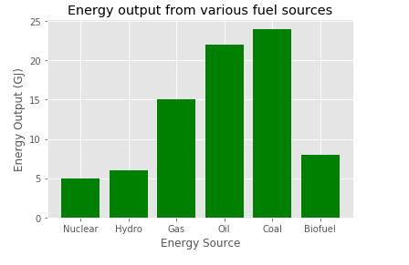
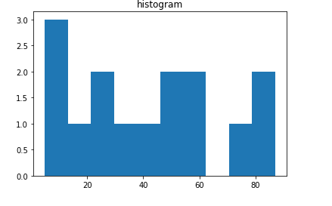
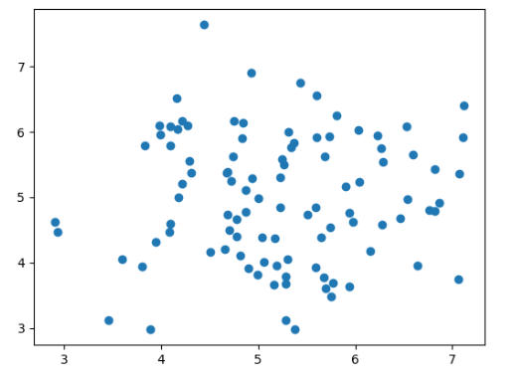
TYPES OF PLOTS
Bar plot
Histogram
Scatter Plot

Slide 21
Bar Plot:
Bar graphs are one of the most common types of graphs and are used to show data associated with the categorical variables. Matplotlib provides a bar() to make bar graphs which accepts arguments such as: categorical variables, their value and color.
Histogram:
A histogram is a type of bar plot that shows the frequency of a number of values compared to a set of values ranges.

Slide 22
Scatter plot:
The scatter plots are mostly used for comparing variables when we need to define how much one variable is affected by another variable. The data is displayed as a collection of points. Each point has the value of one variable, which defines the position on the horizontal axes, and the value of other variable represents the position on the vertical axis.

Slide 23
SEABORN
Seaborn is a library for making statistical graphics in Python. It is built on top of matplotib and closely integrated with pandas data structures.
Two types of plots:
Distribution plots
Categorical plots

Slide 24
In distribution plot we have:
displot
Joinplot
Pairplot
In categorical plot we have:
Box plot
Violin plot
Countplot
barplot

Slide 25
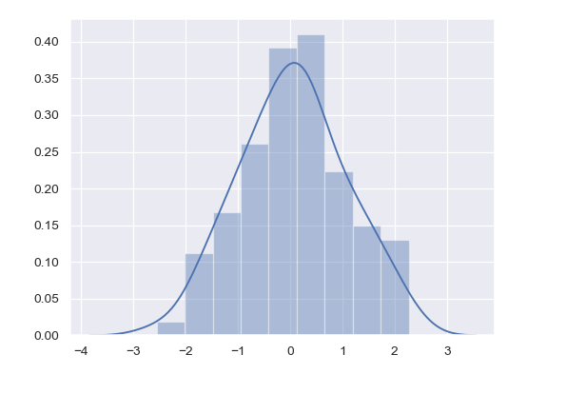
DISTPLOT:
Dist plot helps us to check the distribution of the columns feature

Slide 26
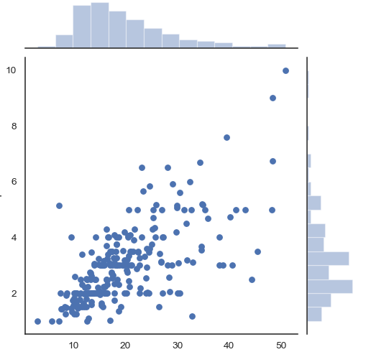
JOIN PLOT
A join plot allows to study the relationship between 2 numeric variables.

Slide 27
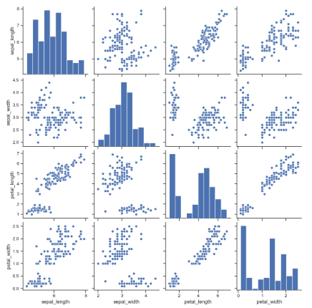
PAIR PLOT
A “pairs plot” is also known as a scatterplot, in which one variable in the same data row is matched with another variable's value, like this: Pairs plots are just elaborations on this, showing all variables paired with all the other variables

Slide 28
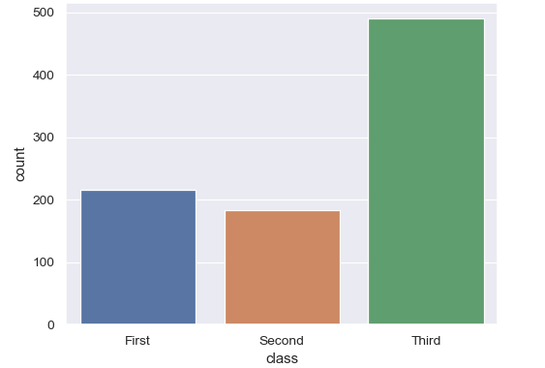
COUNT PLOT
Show the counts of observations in each categorical bin using bars

Slide 29
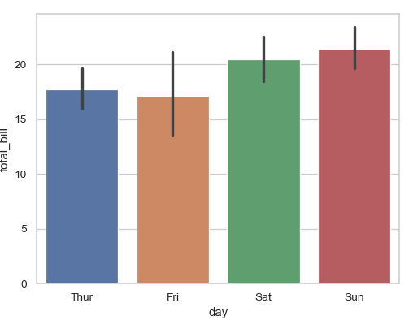
BAR PLOT
Show point estimates and confidence intervals as rectangular bars.

Slide 30
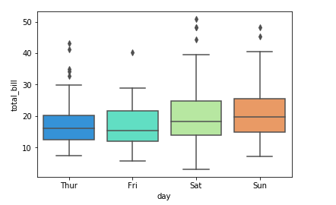
BOX PLOT
A box and whisker plot (sometimes called a boxplot) is a graph that presents information from a five-number summary.

Slide 31
MACHINE LEARNING
Machine learning is an application of artificial intelligence that provides systems the ability to automatically learn and improve from experience without being explicitly programmed. Machine learning focuses on the development of computer programs that can access data and use it learn for themselves
The process of learning begins with observations of data, such as examples, direct experience, or experience or instruction in order to look for patterns in data and make better decisions in the future based on the examples that we provide

Slide 32
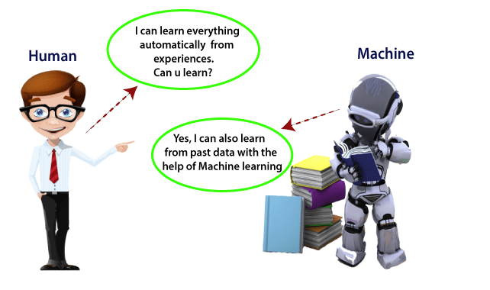

Slide 33
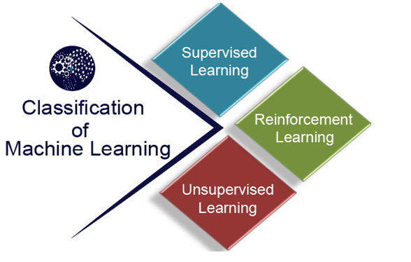
CLASSIFICATION OF MACHINE LEARNING

Slide 34
SUPERVISED LEARNING
It can apply what has been learned in the past to new data using labeled examples to predict future events. Starting from the analysis of a known training dataset, the learning algorithm produces an inferred function to make predictions about the output values. The system is able to provide targets for any new input after sufficient training. The learning algorithm can also compare its output with correct, intended output and find errors in order to modify the model accordingly.
Supervised learning can be grouped further in two categories of algorithms:
Classification
Regression

Slide 35
UNSUPERVISED LEARNING
The training is provided to the machine with the set of data that has not been labeled, classified or categorized, and the algorithm needs to act on that data without any supervision. The goal of unsupervised learning is to restructure the input data into new features or a group of objects with similar patterns.
Here we don’t have a predetermined result. It tries to find useful insights from the huge amount of data. It can be further classified into two
Clustering
Association

Slide 36
REINFORCEMENT LEARNING
Reinforcement learning is a feedback-based learning method, in which a learning agent gets a reward for each right action and gets a penalty for each wrong action. The agent learns automatically with these feedbacks and improves its performance. In reinforcement learning, the agent interacts with the environment and explores it. The goal of an agent is to get the most reward points, and hence, it improves its performance.

Slide 37
LIFE CYCLE OF DATA SCIENCE

Slide 38
EDA(EXPLORATORY DATA ANALYSIS)
Exploratory Data Analysis (EDA), also known as Data Exploration, is a step in the Data Analysis Process, where a number of techniques are used to better understand the dataset being used

Slide 39
EDA DOES….
Extracting important features and leaving behind useless features
Identifying outliers, missing values, or human error
Understanding the relationship(s), or lack of, between features
Ultimately, maximizing your insights of a dataset and minimizing potential error that may occur later in the process

Slide 40
Components of EDA
Understanding your features
Cleaning your dataset
Analyzing relationships between features

Slide 41
FEATURE ENGINEERING
Feature engineering is about creating new input features from your existing ones.
In general, you can think of data cleaning as a process of subtraction and feature engineering as a process of addition.
Preparing the proper input dataset, compatible with the machine learning algorithm requirements.
Improving the performance of machine learning models.

Slide 42
Contd..
Feature engineering involves:
a) Handling missing value
b) Feature Scaling
c)Encoding
d)Handling imbalance data

Slide 43
MISSING VALUES
Why we get missing values?
They hesitate to put down the information
Survey information's are not that valid
General cases as such Men hide their salary and Women hide their age
People might have died which gives NAN

Slide 44
Handling Missing value
To handle the missing data below are the methods:
Mean/ Median/Mode replacement
Random Sample Imputation
Capturing NAN values with a new feature
End of Distribution imputation
Arbitrary imputation

Slide 45
Mean/ Median/Mode replacement:
The NAN are replaced with the most frequent occurrence of the variables
Random Sample Imputation:
Random sample imputation consists of taking random observation from the dataset and we use this observation to replace the nan values
Capturing NAN values with a new feature
End of Distribution imputation:
In this scenario, one would want to replace missing data with values that are at the tails of the distribution of the variable.
Arbitrary imputation:
This technique was derived from kaggle competition It consists of replacing NAN by an arbitrary value

Slide 46
REPLACING WITH MEAN/MEDIAN/MODE
This strategy can be applied on a feature which has numeric data.
We can calculate the mean, median or mode of the feature and replace it with the missing values. This is an approximation which can add variance to the data set. But the loss of the data can be negated by this method which yields better results compared to removal of rows and columns. Replacing with the above three approximations are a statistical approach of handling the missing values. This method is also called as leaking the data while training.
Mean()
Median()
Mode()

Slide 47
ASSIGNING AN UNIQUE CATEGORY
A categorical feature will have a definite number of possibilities. This strategy will add more information into the dataset which will result in the change of variance. Since they are categorical, we need to find one hot encoding to convert it to a numeric form for the algorithm to understand it.
fillna()

Slide 48
DELETING ROWS
Here, we either delete a particular row if it has a null value for a particular feature and a particular column if it has more than 70-75% of missing values. This method is advised only when there are enough samples in the data set. One has to make sure that after we have deleted the data, there is no addition of bias. Removing the data will lead to loss of information which will not give the expected results while predicting the output.
Dropna (inplace=True)

Slide 49
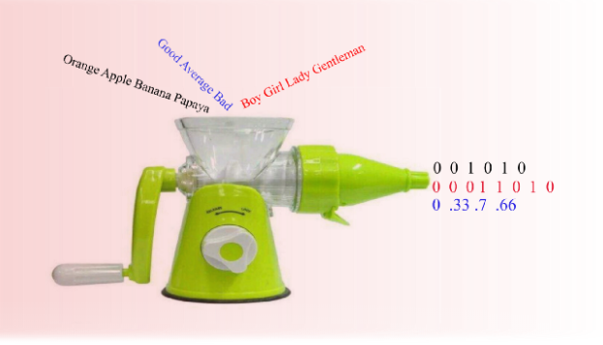
ENCODING
It is the process of transforming a categorical variable into a continuous variable and using them in the model.
Most of the algorithms cannot handle the categorical variables unless they are converted into a numerical value.

Slide 50
TYPES OF ENCODING
Nominal Encoding:
Variable comprises a finite set of discrete values with no relationship between values.
Ordinal Encoding:
Variable comprises a finite set of discrete values with a ranked ordering between values.

Slide 51
FEATURE SCALING
In many machine learning algorithms, to bring all features in the same standing, we need to do scaling so that one significant number doesn’t impact the model just because of their large magnitude.
The most common techniques of feature scaling are
Normalization
Standardization

Slide 52
NORMALIZATION
Normalization is a scaling technique in which values are shifted and rescaled so that they end up ranging between 0 and 1. It is also known as Min-Max scaling.
Formula for normalization:
x`=(x-xmin)/(xmax-xmin)
Here, Xmax and Xmin are the maximum and the minimum values of the feature respectively.
When the value of X is the minimum value in the column, the numerator will be 0, and hence X’ is 0
On the other hand, when the value of X is the maximum value in the column, the numerator is equal to the denominator and thus the value of X’ is 1
If the value of X is between the minimum and the maximum value, then the value of X’ is between 0 and 1

Slide 53
STANDARDIZATION
Standardization is another scaling technique where the values are centered around the mean with a unit standard deviation. This means that the mean of the attribute becomes zero and the resultant distribution has a unit standard deviation.
Formula for standardization:
x`= (x-u)/sigma
u is the mean of the feature values and sigma is the standard deviation of the feature values. Note that in this case, the values are not restricted to a particular range.

Slide 54
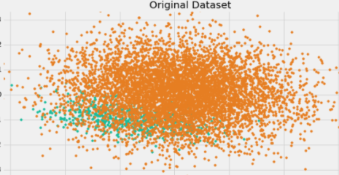
HANDLING IMBALANCE DATA
The number of observations belonging to one class is significantly lower than those belonging to the other classes.

Slide 55
TWO TECHNIQUES TO HANDLE:
Under Sampling:
This aims to balance class distribution by randomly eliminating majority class examples
Over Sampling:
Increases the number of instances in the minority class by randomly replicating them in order to present a higher representation of the minority class in the sample.

Slide 56
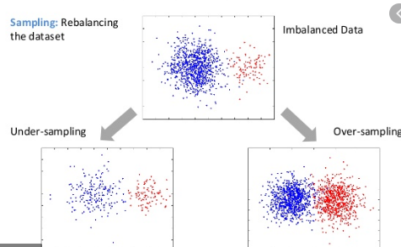

Slide 57
ALGORITHMs
A machine learning algorithm is a method that provides systems the ability to automatically learn and improve from experience without being explicitly programmed.

Slide 58
Learning =
Representation +
Evaluation +
Optimization

Slide 59
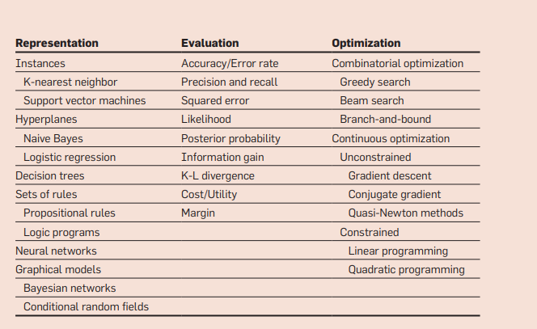

Slide 60
1.LINEAR REGRESSION
Linear Regression is a supervised machine learning algorithm where the predicted output is continuous and has a constant slope. It’s used to predict values within a continuous range, (e.g. sales, price) rather than trying to classify them into categories (e.g. cat, dog). There are two main types:
Simple regression:
Simple linear regression uses traditional slope-intercept form, where m and b are the variables our algorithm will try to “learn” to produce the most accurate predictions. X represent our input data and y represents our prediction.
y=mx+b
Multivariable regression:
A more complex, multi-variable linear equation might look like this, where w represents the coefficients, or weights, our model will try to learn.
f(x,y,z)=w1x+w2y+w3z

Slide 61
TERMS IN LINEAR REGRESSION
Gradient Descent
Regression Error
Residual Error

Slide 62
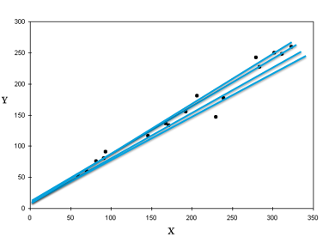
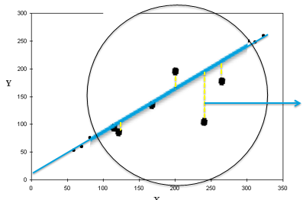
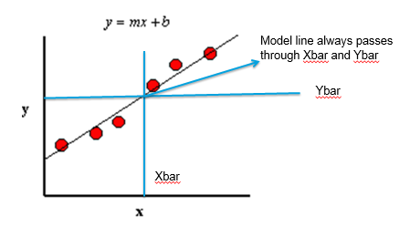
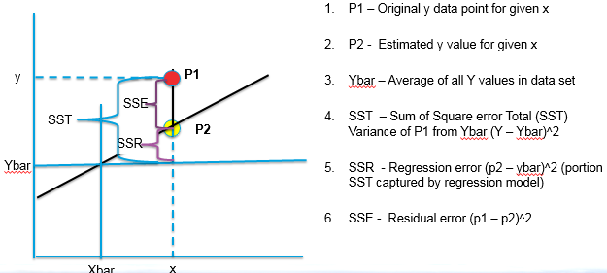

Slide 63
FINDING THE BEST FIT LINE:
When working with linear regression, our main goal is to find the best fit line that means the error between predicted values and actual values should be minimized. The best fit line will have the least error.
The different values for weights or the coefficient of lines (a₀, a₁) gives a different line of regression, so we need to calculate the best values for a₀ and a₁ to find the best fit line, so to calculate this we use cost function.
We can use the cost function to find the accuracy of the mapping function, which maps the input variable to the output variable. This mapping function is also known as Hypothesis function

Slide 64
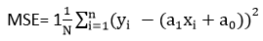
For Linear Regression, we use the Mean Squared Error (MSE) cost function, which is the average of squared error occurred between the predicted values and actual values. It can be written as:
For the above linear equation, MSE can be calculated as:
Where,
N=Total number of observation Yi = Actual value (a1x_{i}+a₀)= Predicted value.

Slide 65
2.LOGISTIC REGRESSION
Logistic regression is a classification algorithm used to assign observations to a discrete set of classes.
Unlike linear regression which outputs continuous number values, logistic regression transforms its output using the logistic sigmoid function to return a probability value which can then be mapped to two or more discrete classes.

Slide 66
Types of logistic regression
Binary (Pass/Fail)
Multi (Cats, Dogs, Sheep)
Ordinal (Low, Medium, High)

Slide 67
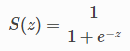
SIGMOID ACTIVATION
In order to map predicted values to probabilities, we use the sigmoid function. The function maps any real value into another value between 0 and 1. In machine learning, we use sigmoid to map predictions to probabilities.
s(z)=output between 0 and 1 (probability estimate)
z=input to the function (your algorithm’s prediction e.g. mx + b)

Slide 68
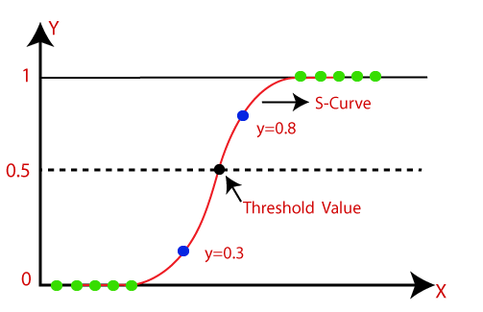

Slide 69
3.KNN ALGORITHM
K-Nearest Neighbour is one of the simplest Machine Learning algorithms based on Supervised Learning technique.
K-NN algorithm assumes the similarity between the new case/data and available cases and put the new case into the category that is most similar to the available categories.
K-NN algorithm stores all the available data and classifies a new data point based on the similarity. This means when new data appears then it can be easily classified into a well suite category by using K- NN algorithm.
Example: Suppose, we have an image of a creature that looks similar to cat and dog, but we want to know either it is a cat or dog. So for this identification, we can use the KNN algorithm, as it works on a similarity measure. Our KNN model will find the similar features of the new data set to the cats and dogs images and based on the most similar features it will put it in either cat or dog category.

Slide 70
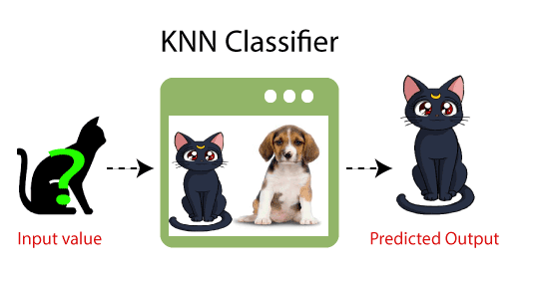

Slide 71
WORKING OF KNN
The K-NN working can be explained on the basis of the below algorithm:
Step-1: Select the number K of the neighbors
Step-2: Calculate the Euclidean distance of K number of neighbors
Step-3: Take the K nearest neighbors as per the calculated Euclidean distance.
Step-4: Among these k neighbors, count the number of the data points in each category.
Step-5: Assign the new data points to that category for which the number of the neighbor is maximum.
Step-6: Our model is ready.

Slide 72
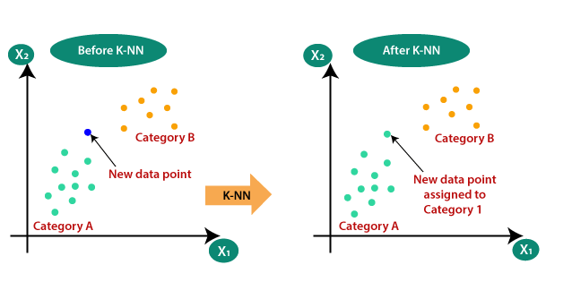

Slide 73
4.SVM (SUPPORT VECTOR MACHINE)
The goal of the SVM algorithm is to create the best line or decision boundary that can segregate n-dimensional space into classes so that we can easily put the new data point in the correct category in the future. This best decision boundary is called a hyperplane.
SVM chooses the extreme points/vectors that help in creating the hyperplane. These extreme cases are called as support vectors, and hence algorithm is termed as Support Vector Machine

Slide 74
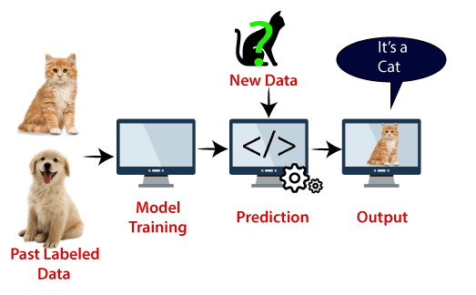

Slide 75
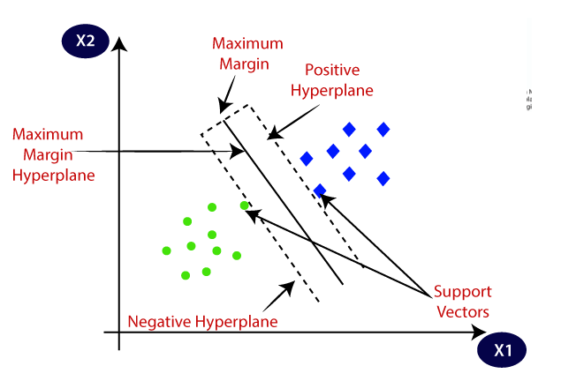

Slide 76
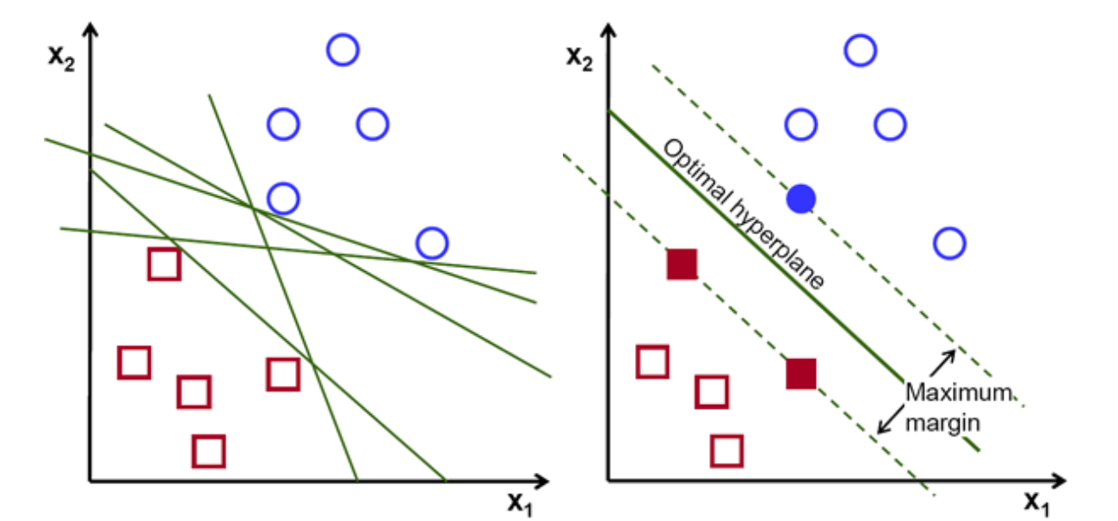

Slide 77
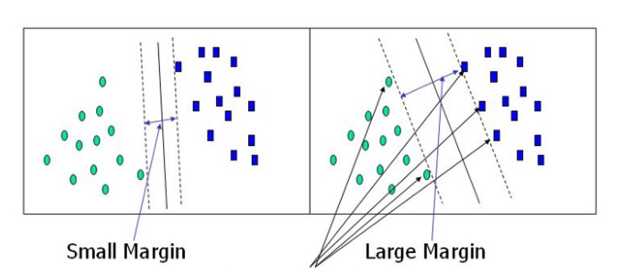

Slide 78
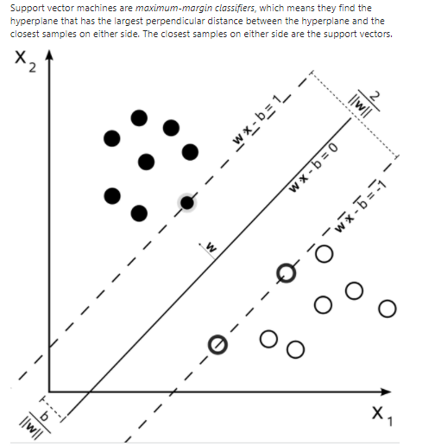

Slide 79
Types of SVM
SVM can be of two types:
Linear SVM: Linear SVM is used for linearly separable data, which means if a dataset can be classified into two classes by using a single straight line, then such data is termed as linearly separable data, and classifier is used called as Linear SVM classifier.
Non-linear SVM: Non-Linear SVM is used for non-linearly separated data, which means if a dataset cannot be classified by using a straight line, then such data is termed as non-linear data and classifier used is called as Non-linear SVM classifier.

Slide 80
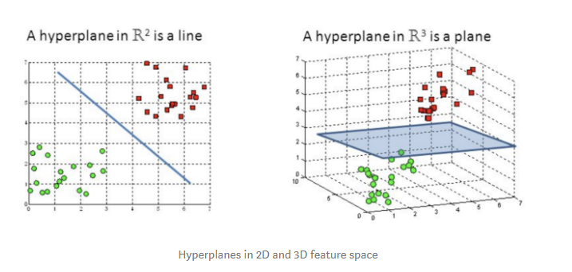

Slide 81
TUNING PARAMETERS
Kernel
The learning of the hyperplane in linear SVM is done by transforming the problem using some linear algebra. This is where the kernel plays role.
For linear kernel the equation for prediction for a new input using the dot product between the input (x) and each support vector (xi) is calculated as follows:
f(x) = B(0) + sum(ai * (x,xi))
This is an equation that involves calculating the inner products of a new input vector (x) with all support vectors in training data. The coefficients B0 and ai (for each input) must be estimated from the training data by the learning algorithm.

Slide 82
Regularization
The Regularization parameter (often termed as C parameter in python’s sklearn library) tells the SVM optimization how much you want to avoid misclassifying each training example.
For large values of C, the optimization will choose a smaller-margin hyperplane if that hyperplane does a better job of getting all the training points classified correctly. Conversely, a very small value of C will cause the optimizer to look for a larger-margin separating hyperplane, even if that hyperplane misclassifies more points.

Slide 83
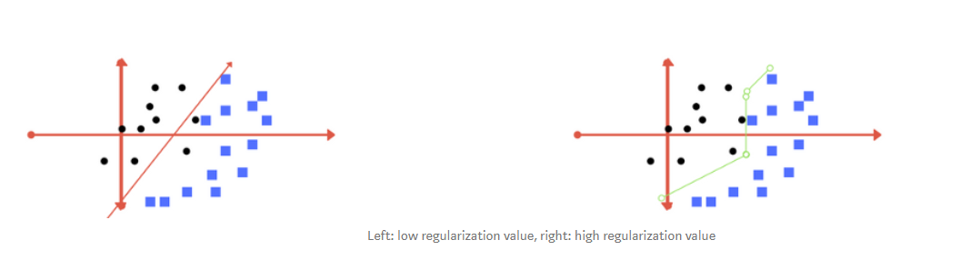
The images below (same as image 1 and image 2 in section 2) are example of two different regularization parameter. Left one has some misclassification due to lower regularization value. Higher value leads to results like right one.

Slide 84
Gamma
The gamma parameter defines how far the influence of a single training example reaches, with low values meaning ‘far’ and high values meaning ‘close’. In other words, with low gamma, points far away from plausible seperation line are considered in calculation for the seperation line. Where as high gamma means the points close to plausible line are considered in calculation.

Slide 85
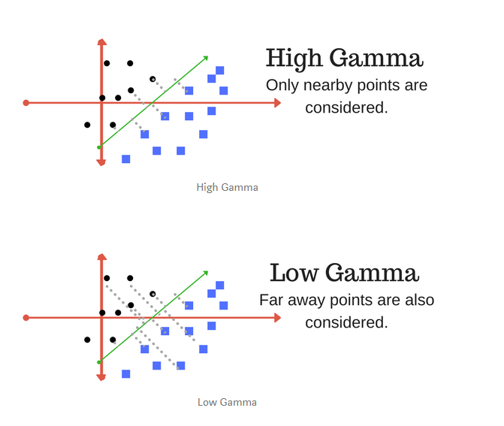

Slide 86
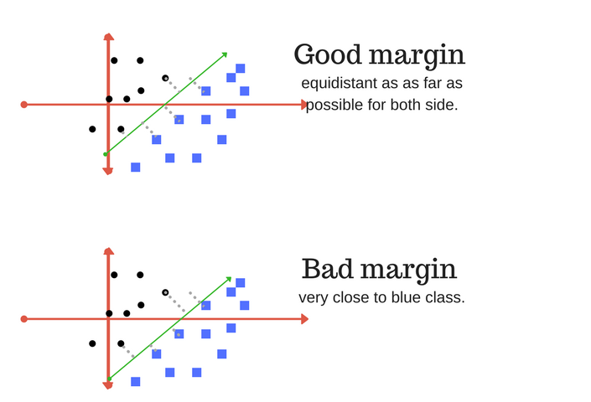

Slide 87
5.Decision tree
It is a tree-structured classifier, where internal nodes represent the features of a dataset, branches represent the decision rules and each leaf node represents the outcome.
In a Decision tree, there are two nodes, which are the Decision Node and Leaf Node. Decision nodes are used to make any decision and have multiple branches, whereas Leaf nodes are the output of those decisions and do not contain any further branches.

Slide 88
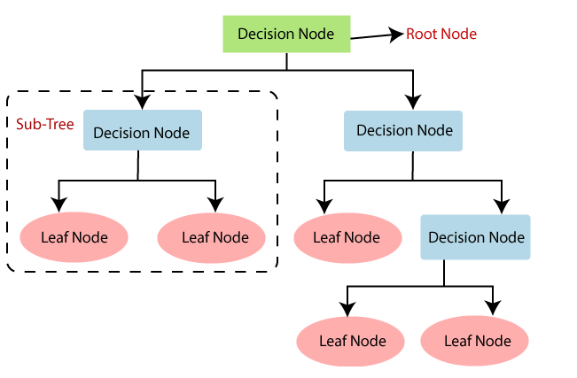

Slide 89
WORKING OF DECISION TREE
In a decision tree, for predicting the class of the given dataset, the algorithm starts from the root node of the tree. This algorithm compares the values of root attribute with the record (real dataset) attribute and, based on the comparison, follows the branch and jumps to the next node.
For the next node, the algorithm again compares the attribute value with the other sub-nodes and move further. It continues the process until it reaches the leaf node of the tree.
The complete process can be better understood using the below algorithm:
Step-1: Begin the tree with the root node, says S, which contains the complete dataset.
Step-2: Find the best attribute in the dataset using Attribute Selection Measure (ASM).
Step-3: Divide the S into subsets that contains possible values for the best attributes.
Step-4: Generate the decision tree node, which contains the best attribute.
Step-5: Recursively make new decision trees using the subsets of the dataset created in step -3. Continue this process until a stage is reached where you cannot further classify the nodes and called the final node as a leaf node.

Slide 90
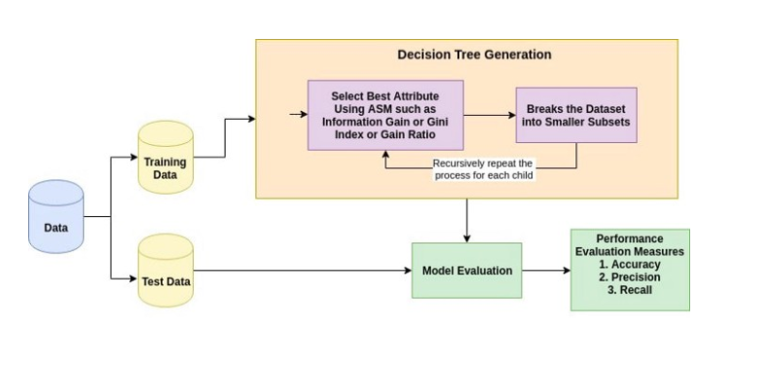

Slide 91
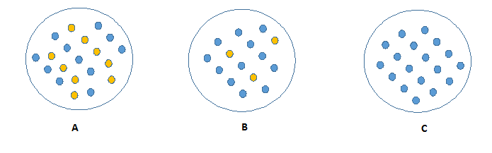
INFORMATION GAIN
Information gain is a statistical property that measures how well a given attribute separates the training examples according to their target classification
Less impure node requires less information to describe it. And, the more impure node requires more information.

Slide 92
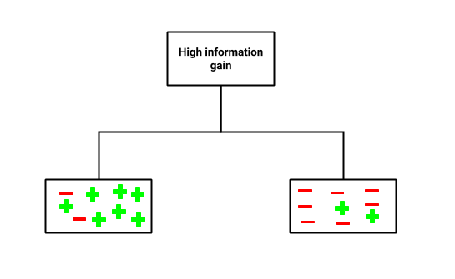
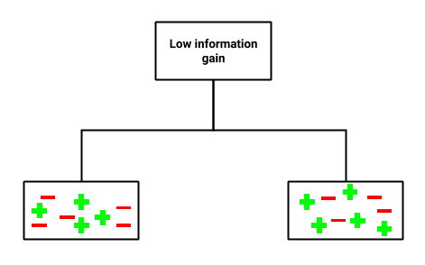
An attribute with low information gain (bottom) splits the data relatively evenly and as a result doesn’t bring us any closer to a decision. Whereas, an attribute with high information gain (top) splits the data into groups with an uneven number of positives and negatives and as a result, helps in separating the two from each other

Slide 93
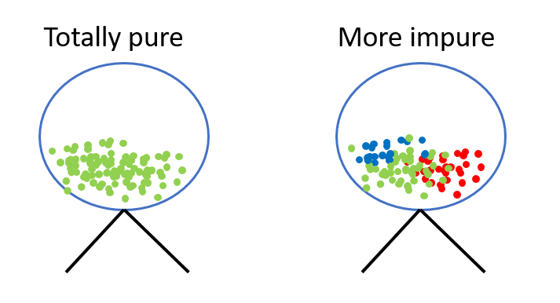
ENTROPY
Entropy referred to as the randomness or the impurity in the system. In information theory, it refers to the impurity in a group of examples. Information gain is a decrease in entropy.

Slide 94
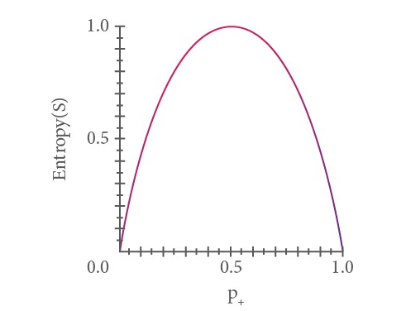
Entropy is 0 if all the members of S belong to the same class. For example, if all members are positive, Entropy(S) = 0. Entropy is 1 when the sample contains an equal number of positive and negative examples. If the sample contains an unequal number of positive and negative examples, entropy is between 0 and 1.

Slide 95
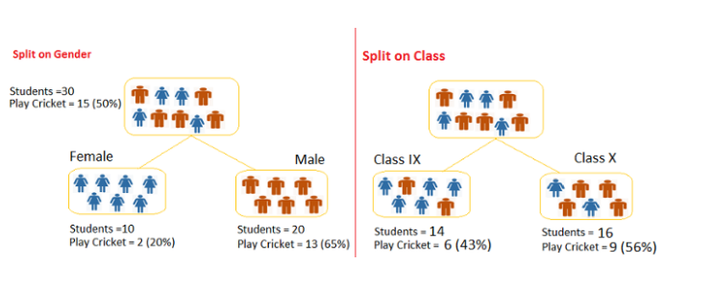
CALCULATION OF ENTROPY AND INFORMATION GAIN
Information Gain = Entropy(parent node) — [Avg Entropy(children)]
Entropy= -plog2p-qlog2q

Slide 96
GINI IMPURITY
Gini says, if we select two items from a population at random then they must be of same class and probability for this is 1 if population is pure.
It works with categorical target variable “Success” or “Failure”.
It performs only Binary splits
Higher the value of Gini higher the homogeneity.
CART (Classification and Regression Tree) uses the Gini method to create binary splits.

Slide 97
STEPS TO CALCULATE GINI FOR A SPLIT
Calculate Gini for sub-nodes, using formula sum of the square of probability for success and failure (p²+q²).
Calculate Gini for split using weighted Gini score of each node of that split

Slide 98
OPTIMIZING DECISION TREE PERFORMANCE
criterion: This parameter determines how the impurity of a split will be measured. The default value is “gini” but you can also use “entropy” as a metric for impurity.
splitter: This is how the decision tree searches the features for a split. The default value is set to “best”. That is, for each node, the algorithm considers all the features and chooses the best split. If you decide to set the splitter parameter to “random,” then a random subset of features will be considered. The split will then be made by the best feature within the random subset. The size of the random subset is determined by the max_features parameter. This is partly where a Random Forest gets its name.

Slide 99
max_depth: This determines the maximum depth of the tree. In our case, we use a depth of two to make our decision tree. The default value is set to none. This will often result in over-fitted decision trees. The depth parameter is one of the ways in which we can regularize the tree, or limit the way it grows to prevent over-fitting.
min_samples_split: The minimum number of samples a node must contain to consider splitting. The default value is two. You can use this parameter to regularize your tree.
min_samples_leaf: The minimum number of samples needed to be considered a leaf node. The default value is set to one. Use this parameter to limit the growth of the tree.
max_features: The number of features to consider when looking for the best split. If this value is not set, the decision tree will consider all features available to make the best split. Depending on your application, it’s often a good idea to tune this parameter.

Slide 100
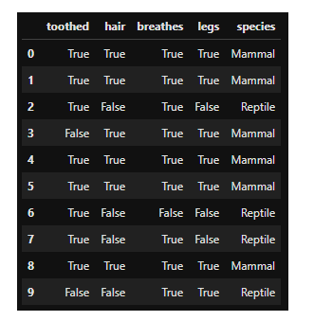
Example

Slide 101
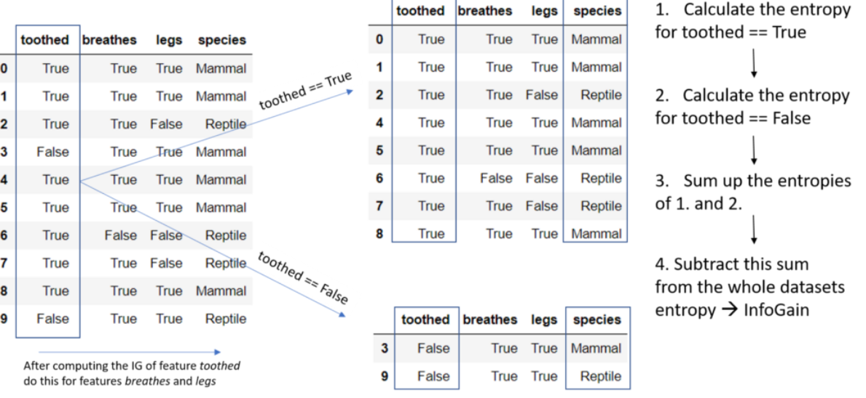

Slide 102
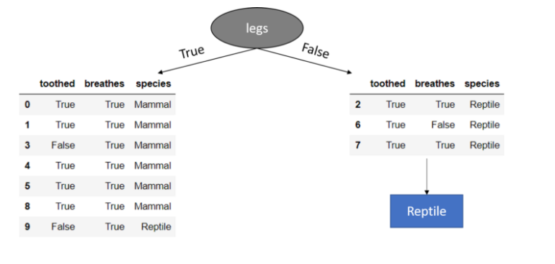

Slide 103
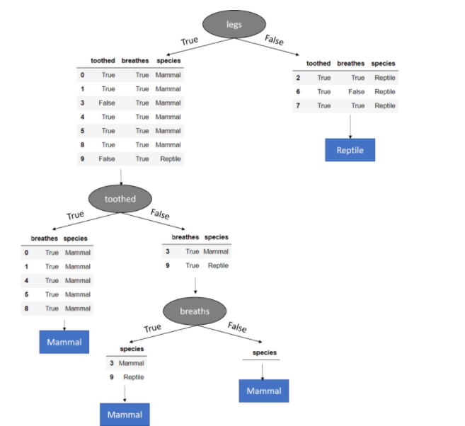

Slide 104



Bootstrap Sampling Method
Bootstrap sampling method is a resampling method that uses random sampling with replacement.
This means that it is very much possible for an already chosen observation to be chosen again

Slide 105

ENSEMBLE LEARNING
Ensemble learning is a method where multiple learning algorithms are used in conjunction. The purpose of doing so is that it allows you to achieve higher predictive performance than if you were to use an individual algorithm by itself.

Slide 106

ENSEMBLE METHODS: BAGGING AND BOOSTING.
Bagging, also known as bootstrap aggregating, is the process in which multiple models of the same learning algorithm are trained with bootstrapped samples of the original dataset.

Slide 107

Boosting is a variation of bagging where each individual model is built sequentially, iterating over the previous one. Specifically, any data points that are falsely classified by the previous model is emphasized in the following model

Slide 108
Once the first model is built, the falsely classified/predicted points are taken in addition to the second bootstrapped sample to train the second model. Then, the ensemble model (models 1 and 2) are used against the test dataset and the process continues.

Slide 109


Slide 110
6.RANDOM FOREST
"Random Forest is a classifier that contains a number of decision trees on various subsets of the given dataset and takes the average to improve the predictive accuracy of that dataset."
Instead of relying on one decision tree, the random forest takes the prediction from each tree and based on the majority votes of predictions, and it predicts the final output.

Slide 111


Slide 112
WORKING OF RANDOM FOREST
Random Forest works in two-phase first is to create the random forest by combining N decision tree, and second is to make predictions for each tree created in the first phase.
The Working process can be explained in the below steps and diagram:
Step-1: Select random K data points from the training set.
Step-2: Build the decision trees associated with the selected data points (Subsets).
Step-3: Choose the number N for decision trees that you want to build.
Step-4: Repeat Step 1 & 2.
Step-5: For new data points, find the predictions of each decision tree, and assign the new data points to the category that wins the majority votes.

Slide 113
PARAMETERS
n_estimators: The n_estimators parameter specifies the number of trees in the forest of the model. The default value for this parameter is 10, which means that 10 different decision trees will be constructed in the random forest.
2. max_depth: The max_depth parameter specifies the maximum depth of each tree. The default value for max_depth is None, which means that each tree will expand until every leaf is pure. A pure leaf is one where all of the data on the leaf comes from the same class.
3. min_samples_split: The min_samples_split parameter specifies the minimum number of samples required to split an internal leaf node. The default value for this parameter is 2, which means that an internal node must have at least two samples before it can be split to have a more specific classification.
4. min_samples_leaf: The min_samples_leaf parameter specifies the minimum number of samples required to be at a leaf node. The default value for this parameter is 1, which means that every leaf must have at least 1 sample that it classifies.

Slide 114


Slide 115
ADABOOST
Adaptive Boosting,” is a boosting ensemble machine learning algorithm, and was one of the first successful boosting approaches.
We call the algorithm AdaBoost because, unlike previous algorithms, it adjusts adaptively to the errors of the weak hypotheses
Combines multiple classifiers to increase the accuracy of classifiers.
AdaBoost is an iterative ensemble method. The classifier builds a strong classifier by combining multiple poorly performing classifiers so that you will get high accuracy strong classifier.
The basic concept behind Adaboost is to set the weights of classifiers and training the data sample in each iteration such that it ensures the accurate predictions of unusual observations. Any machine learning algorithm can be used as base classifier if it accepts weights on the training set. Adaboost should meet two conditions:

Slide 116
The classifier should be trained interactively on various weighed training examples.
In each iteration, it tries to provide an excellent fit for these examples by minimizing training error.
For regression instead of the exponential loss function, we use a variation of the squared error function. In sklearn, it is implemented as AdaBoostRegressor.

Slide 117
STEPS OF ALGORITHM:
Step 1: Initialize the sample weights
Step 2: Build a decision tree with each feature, classify the data and evaluate the result
Step 3: Calculate the significance of the tree in the final classification
Step 4: Update the sample weights so that the next decision tree will take the errors made by the preceding decision tree into account
Step 5: Form a new dataset
Step 6: Repeat steps 2 through 5 until the number of iterations equals the number specified by the hyper parameter (i.e. number of estimators)

Slide 118


Slide 119

INITIALIZE THE SAMPLE WEIGHTS

Slide 120


Slide 121



Slide 122



Slide 123


Slide 124


Slide 125

GRADIENT BOOSTING

Slide 126

Gradient Boosting is an iterative functional gradient algorithm, i.e an algorithm which minimizes a loss function by iteratively choosing a function that points towards the negative gradient; a weak hypothesis.
The term "Gradient" in Gradient Boosting refers to the fact that you have two or more derivatives of the same function (we'll cover this in more detail later on).
A fixed number of trees are added or training stops once loss reaches an acceptable level or no longer improves on an external validation dataset.

Slide 127
GRADIENT BOOSTING HAS THREE MAIN COMPONENTS:
Loss Function - The role of the loss function is to estimate how good the model is at making predictions with the given data.
Weak Learner - A weak learner is one that classifies our data but does so poorly, perhaps no better than random guessing. In other words, it has a high error rate
Additive Model - This is the iterative and sequential approach of adding the trees (weak learners) one step at a time. After each iteration, we need to be closer to our final model. In other words, each iteration should reduce the value of our loss function.

Slide 128
Steps:
Generate some predictions
2.Calculate the loss
3.Calculate the pseudo-residuals
4.Train a model on the pseudo-residuals
5.Compute a multiplier
6.Repeat!

Slide 129
Learning Rate is used to scale the contribution from the new tree. This results in a small step in the right direction of prediction. Empirical evidence has proven that taking lots of small steps in the right direction results in better prediction with a testing dataset i.e the dataset that the model has never seen as compared to the perfect prediction in 1st step. Learning Rate is usually a small number like 0.1

Slide 130
SUMMARY
The very first model that a boosting algorithm creates is a constant model. This is a model that predicts a constant value regardless of what it’s given as inputs.
At each step after that, the algorithm finds the gradients of the loss function and trains a new model on those gradients.
Because of mathemagic, repeating this procedure leads to increasingly accurate predictions.

Slide 131
xgboost
XGBoost is an implementation of the Gradient Boosted Decision Trees Algorithm
It is a decision-tree-based ensemble Machine Learning algorithm that uses gradient boosting framework.
XGBoost and Gradient Boosting Machines(GBMs) are both ensemble tree methods that apply the principle of boosting weak learners using the gradient descent architecture. However,XGBoost improves upon the base GBM framework through systems optimization and algorithmic enhancements.

Slide 132

EXAMPLE:

Slide 133

We start with an arbitrary initial prediction. This could be the average in the case of regression and 0.5 in the case of classification.

Slide 134
For every sample we calculate the residual with the proceeding formula.
residual=actual value – predicted value
Suppose, after applying the formula, we end up with the following residuals, starting with the samples from left to right.

Slide 135


We use linear scan to decide the best split along the given features (Square Footage). By linear scan, we mean that we need to select a threshold between the first pair of points (their average), then select a threshold between the next pair of points(their average) and so on until we've explored all possibilities

Slide 136


Slide 137

Lambda and Gamma are both hyperparameters. Lambda is a regularization parameter that reduces the prediction's sensitivity to individual observations, whereas Gamma is the minimum loss reduction required to make a further partition on a leaf node of the tree.
We arbitrarily set Lambda and gamma to the following.

Slide 138


Slide 139




Slide 140




Slide 141




Slide 142

The decision tree must return a single scalar value. Therefore we use to following formula that takes into account multiple residuals in a single leaf node.

Slide 143


The first prediction is the sum of the initial prediction and the prediction made by the tree multiplied by the learning rate.
Assuming a learning rate of 0.5, the model makes the following predictions
The new residuals are:

Slide 144

We then use the residuals to construct another decision tree, and repeat the process until we have reached the maximum number of estimators (default of 100). Once we have finished training the model, the predictions made by the XGBoost model as a whole are the sum of the initial prediction and the predictions made by each individual decision tree multiplied by the learning rate.

Slide 145
7.K MEANS CLUSTERING
It is an iterative algorithm that divides the unlabeled dataset into k different clusters in such a way that each dataset belongs only one group that has similar properties.
It is an Unsupervised Learning algorithm, which groups the unlabeled dataset into different clusters. Here K defines the number of pre-defined clusters that need to be created in the process, as if K=2, there will be two clusters, and for K=3, there will be three clusters, and so on.

Slide 146
WORKING OF K-MEANS ALGORITHM
The working of the K-Means algorithm is explained in the below steps:
Step-1: Select the number K to decide the number of clusters.
Step-2: Select random K points or centroids. (It can be other from the input dataset).
Step-3: Assign each data point to their closest centroid, which will form the predefined K clusters.
Step-4: Calculate the variance and place a new centroid of each cluster.
Step-5: Repeat the third steps, which means reassign each datapoint to the new closest centroid of each cluster.
Step-6: If any reassignment occurs, then go to step-4 else go to FINISH.
Step-7: The model is ready.

Slide 147



Slide 148


Slide 149
Initialize Cluster Centroids (Choose those 3 books to start with)
Assign data points to Clusters (Place remaining the books one by one)
Update Cluster centroids (Start over with 3 different books)
Repeat step 2–3 until the stopping condition is met.

Slide 150


Slide 151
The method is to use the value of inertia. The idea behind good clustering is having a small value of inertia, and small number of clusters.
The value of inertia decreases as the number of clusters increase. So, it’s a trade-off here.
Rule of thumb: The elbow pint is the inertia graph is a good choice because after that change In the value of inertia isn't significant.

Slide 152
METRICS

Slide 153

R2 AND ADJUSTED R2
R-squared method:
R-squared, also known as the coefficient determination, defines the degree to which the variance in the dependent variable (or target) can be explained by the independent variable (features).
Ideally, the independent variables are able to explain all the variation in the target variable. In that scenario, the r-squared value would be 1. Thus we can say that higher the r-squared value, better in the model.
It can be calculated from the below formula

Slide 154
Drawback of r-squared is that it assumes every variable helps in explaining the variation in the target, which might not always be true. For instance, if we add a new features to the data (which may or may not be useful), the r-squared value for the model would either increase or remain same but it would never decrease.

Slide 155

2. Adjusted R2:
Adjusted R-squared measures the variation in the dependent variable (or target), explained by only the features which are helpful in making predictions.
It penalizes for adding features which are not useful for predicting the target.
N is the number of rows and M is the number of columns. As the number of feature increases, the value in the denominator decreases.
If the R2 increases by a significant value, then the adjusted r-squared would increase.
If there is no significant change in R2, then the adjusted r2 would decrease

Slide 156
CLASSIFICATION METRICS
Metrics are used to monitor and measure the performance of a model (during training, and test.
Below are few classification metrics:
CONFUSION MATRIX
ACCURACY
PRECISION AND RECALL
F1 SCORE

Slide 157

CONFUSION MATRIX
A confusion matrix is a summary of prediction results on a classification problem.
It shows the ways in which our classification model is confused when it makes predictions.

Slide 158


Slide 159

EXAMPLE

Slide 160

ACCURACY
Accuracy is the ratio of number of correct predictions to the total number of input samples.
It works well only if there are equal number of samples belonging to each class.

Slide 161
PRECISION AND RECALL
Precision means the percentage of your results which are relevant.
Recall refers to the percentage of total relevant results correctly classified by your algorithm.

Slide 162


Slide 163


Out of all the positive classes, how much we predicted correctly. It should be high as possible.
Out of all the positive classes we have predicted correctly, how many are actually positive.

Slide 164

F1 SCORE
If we are trying to get the best precision and recall at the same time. F1-Score is the harmonic mean of precision and recall values for a classification problem.

Slide 165
The Fbeta-measure is a generalization of the F-measure that adds a configuration parameter called beta. A default beta value is 1.0, which is the same as the F-measure. A smaller beta value, such as 0.5, gives more weight to precision and less to recall, whereas a larger beta value, such as 2.0, gives less weight to precision and more weight to recall in the calculation of the score.

Slide 166
HYPER PARAMETER TUNING
Hyper parameters are all the parameters which can be arbitrarily set by the user before starting training
Model parameters are instead learned during the model training
The model parameters define how to use input data to get the desired output and are learned at training time. Instead, Hyper parameters determine how our model is structured in the first place.

Slide 167
Machine Learning models tuning is a type of optimization problem. We have a set of hyper parameters and we aim to find the right combination of their values which can help us to find either the minimum (eg. loss) or the maximum (eg. accuracy) of a function

Slide 168
CROSS-VALIDATION
Cross-validation is a resampling procedure used to evaluate machine learning models on a limited data sample
Indication of how well the learner will generalize to an independent/ unseen data set, this idea about model is known as Cross Validation.

Slide 169
TYPES OF CV:
K-fold CV: In K Fold cross validation, the data is divided into k subsets. Now the holdout method is repeated k times, such that each time, one of the k subsets is used as the test set/ validation set and the other k-1 subsets are put together to form a training set
Stratified CV: a slight variation in the K Fold cross validation technique is made, such that each fold contains approximately the same percentage of samples of each target class as the complete set, or in case of prediction problems, the mean response value is approximately equal in all the folds.

Slide 170


Slide 171
APPROACHES TO HYPER PARAMETER OPTIMIZATION
Grid Search
Random Search

Slide 172
GRID SEARCH
Grid search is arguably the most basic hyper parameter tuning method. With this technique, we simply build a model for each possible combination of all of the hyper parameter values provided, evaluating each model, and selecting the architecture which produces the best results.
When using Grid Search, all the possible combinations of the parameters in the grid are tried.

Slide 173
RANDOM SEARCH
In Random Search, we create a grid of hyper parameters and train/test our model on just some random combination of these hyper parameters
Random search differs from grid search in that we longer provide a discrete set of values to explore for each hyper parameter; rather, we provide a statistical distribution for each hyper parameter from which values may be randomly sampled.

Slide 174


